Slide 1
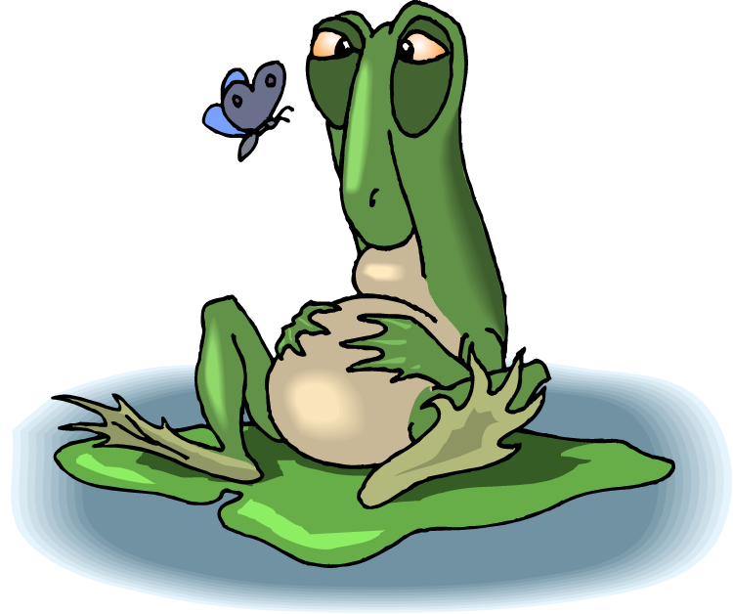
What makes us feel hungry or full?
Metabolic Diseases Lesson 3.3

Slide 2
Why is it so challenging to regulate our weight?
Notes:
Lots pf signals in the brain that regulate hunger and satisfaction

Slide 3
Do Now
What tells us when to eat and when to stop eating?
Signals that relate to actual energy needs in order to maintain homeostasis.
What cues can make you feel hungry?
Remember Pavlov’s dogs!
What is addiction? Can people be addicted to food?
Addiction is the continued use of a mood altering substance despite adverse consequences.

Slide 4
What cues tell you that you want to eat?

Slide 5
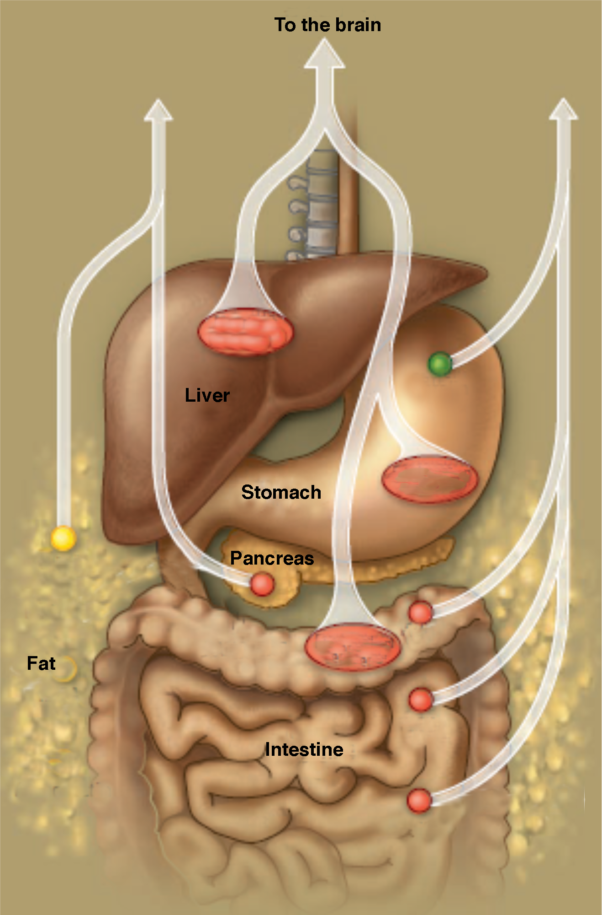
Hunger and satiety signals to the brain
Hunger:
Ghrelin
Satiety:
Status of intestines and liver
Hormones
Insulin
Leptin
Peptides (PYY, CCK)
nutrients
Grehlin
distention
Leptin
PYY
Insulin
distention
CCK
CCK
Notes:
There are many signals from the periphery that play a role in signaling energy needs. Ghrelin is a hormone secreted by the stomach in anticipation of food and is associated with hunger.
Insulin and glucose spike in the blood after eating a meal and signal fullness.
The adipose tissue itself secretes a hormone called leptin. The amount of leptin secreted increases with more fat stores and therefore reflects the amount of energy stores available.

Slide 6
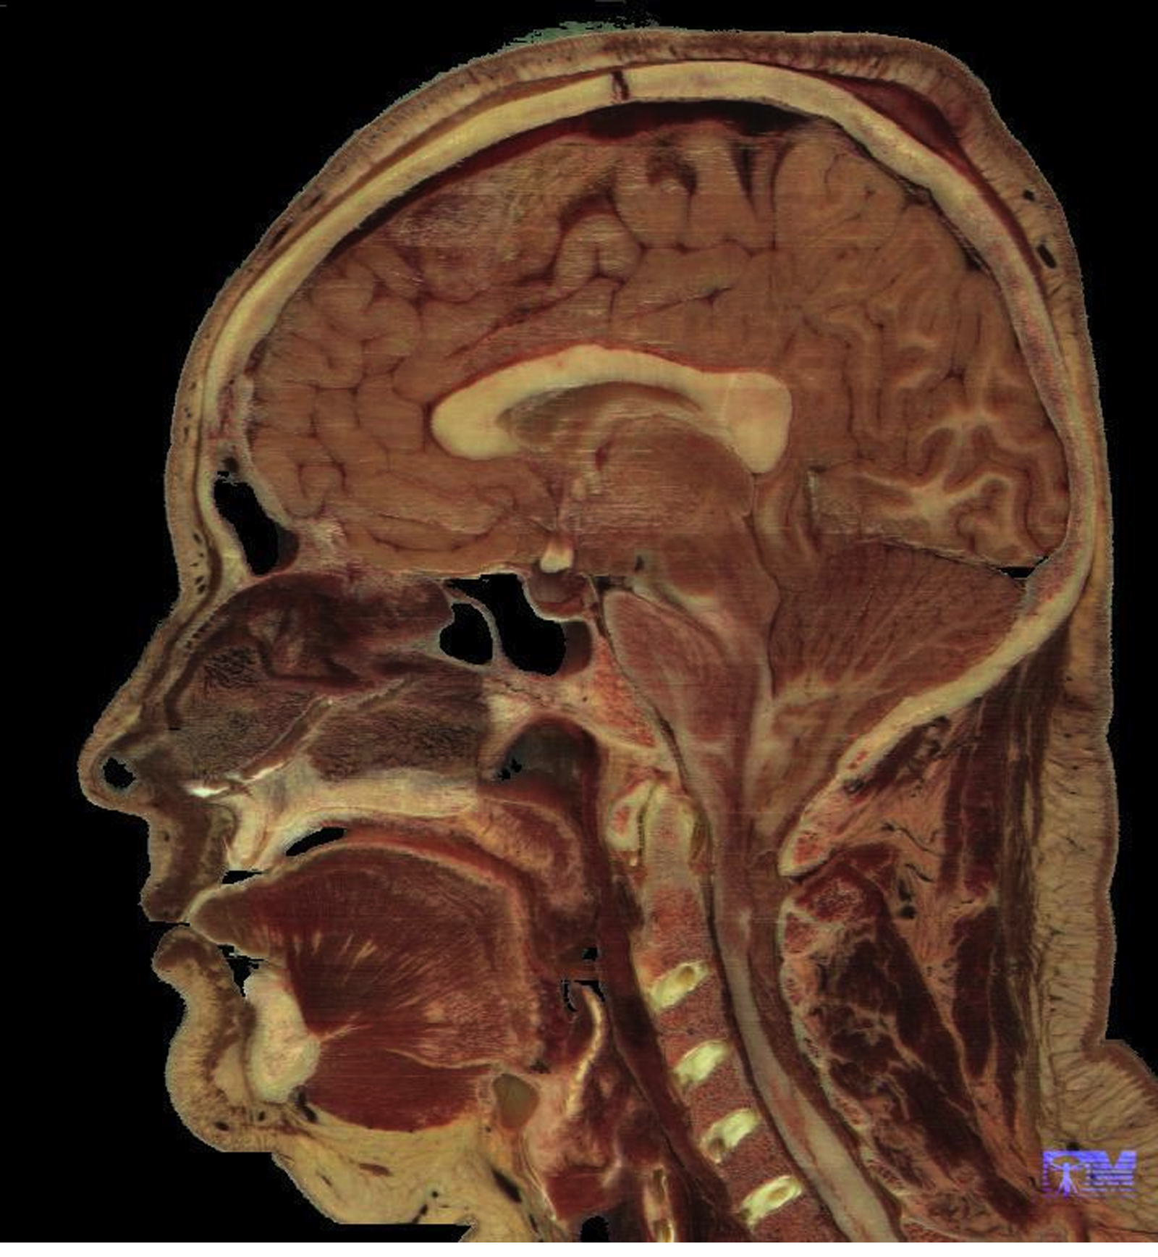
The hypothalamus regulates the brain’s response
Hypothalamus
arbl.cvmbs.colostate.edu

Slide 7
How does the hypothalamus regulate hunger?
Hypothalamus
Arcuate Nucleus
AGRP
Hunger Center
Eat!
Ghrelin
NPY
Leptin & Insulin
Stop Eating!
α-MSH
Satiety Center
Notes:
The hypothalamus is composed of many different groups of neurons called nuclei
One of these nuclei is called the arcuate nucleus
The arcuate nucleus is connected to the the hunger center in the lateral hypothalamus and the satiety center in the paraventricular nucleus of the hypothalamus
When we are hungry the stomach secretes Grehlin. Grehlin acts on the arcuate nucleus which tells the hunger center to eat.
Then when we are full the insulin released in response to the glucose spike and the leptin released from fat tells the satiety center to stop eating.

Slide 8
How does the hypothalamus regulate hunger?
Hypothalamus
Arcuate Nucleus
AGRP
Hunger Center
Eat!
Ghrelin
NPY
Leptin & Insulin
Stop Eating!
α-MSH
Satiety Center
Notes:
When Grehlin acts on the arcuate nucleus it produces 2 neuronal signals Agouti related peptide (AGRP) and neuropeptide Y (NPY)
They signal the hunger center in the lateral hypothalamus to release signals that stop eating.
When insulin and leptin act on the arcuate it produces produce alpha melanocyte stimulating hormone (A-MSH). A MSH tells the satiety center to stop eating.
Leptin and insulin can also inhibit the hunger pathway, both at the level of the arcuate nucleus and at the level of the hunger center

Slide 9
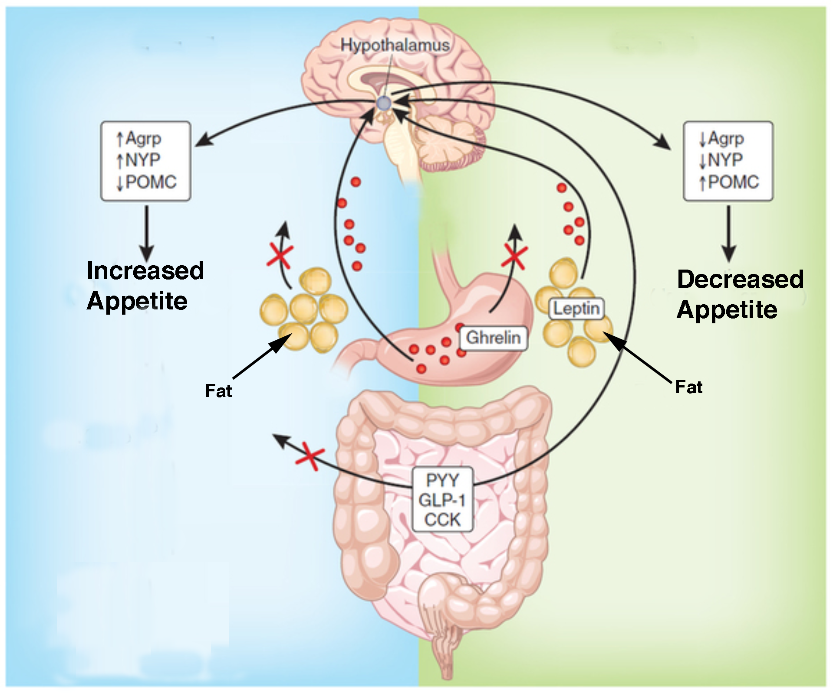
Hunger and Satiety Signals
Fasting
Feeding
⬆AGRP
⬆NPY
⬇AGRP
⬇NPY
Leptin
Grehlin
PYY
CCK
Can these signals be ignored?
Notes:
Ask the students: Can you think of times when these signals may be reaching the brain but we still don’t start or stop eating?

Slide 10
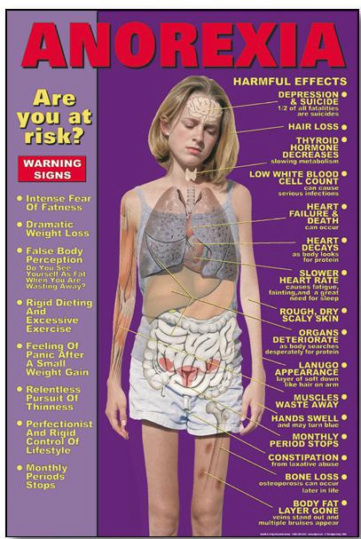
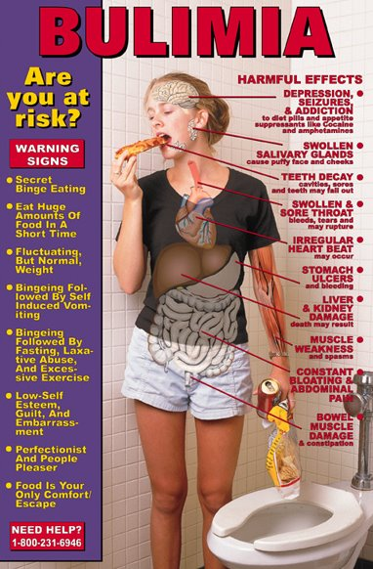
Eating Disorders
People with Anorexia Nervosa or Bulimia Nervosa don’t eat even though they have increased ghrelin, and decreased leptin & CCK
Notes:
Go over some of the risk factors and symptoms of Anorexia Nervosa and Bulimia Nervosa

Slide 11
How might the satiety pathway affect the development of obesity?
Genetic mutations in this pathway can cause obesity but these are rare.
Prader Willi Syndrome: Genetic disorder that causes hypothalamus to not function correctly. Leads to insatiable appetite.

Slide 12
Prader Willi Syndrome
Notes:
2:09 minutes

Slide 13
How might this pathway impact development of obesity?
Genetic mutations in this pathway can cause obesity but these are rare.
Dietary habits can condition the feedback loops. (Can people be addicted to food?)

Slide 14
Hooked: Why bad habits are hard to break
Notes:
8:32 minutes

Slide 15
Wrap Up
Have you changed your opinion on the question: Can people be addicted to food?

Slide 16
Homework
Read the primary research paper in preparation for the Lesson 3.5, using the Lesson 3.5 Worksheet as a reading guide.
Long-Term Persistence of Hormonal Adaptations to Weight Loss.
Priya Sumithran et al. New England Journal of Medicine, 365;17. October 27, 2011

Slide 17
How to read primary papers
Question:
What is the main question of the paper?
Method:
How do they investigate this question?
Data:
Each figure has its own Q,M,D,C
Conclusion:
What conclusions can you make based on the data?

